Slide 1

G- CARE DIABETIC COUNCIL
Partnership with Dept. of Health and Family Welfare Services
(Govt. of Puducherry)
PIU-I-Floor, Old Maternity Hospital Building, Victor Simonel St, Puducherry; Telephone No: 0413-2229790
Email: prcgcdc@gmail.com; Website: www.gcdc2016.com
Dr. T.L Nandagopal M.C.A

Slide 2

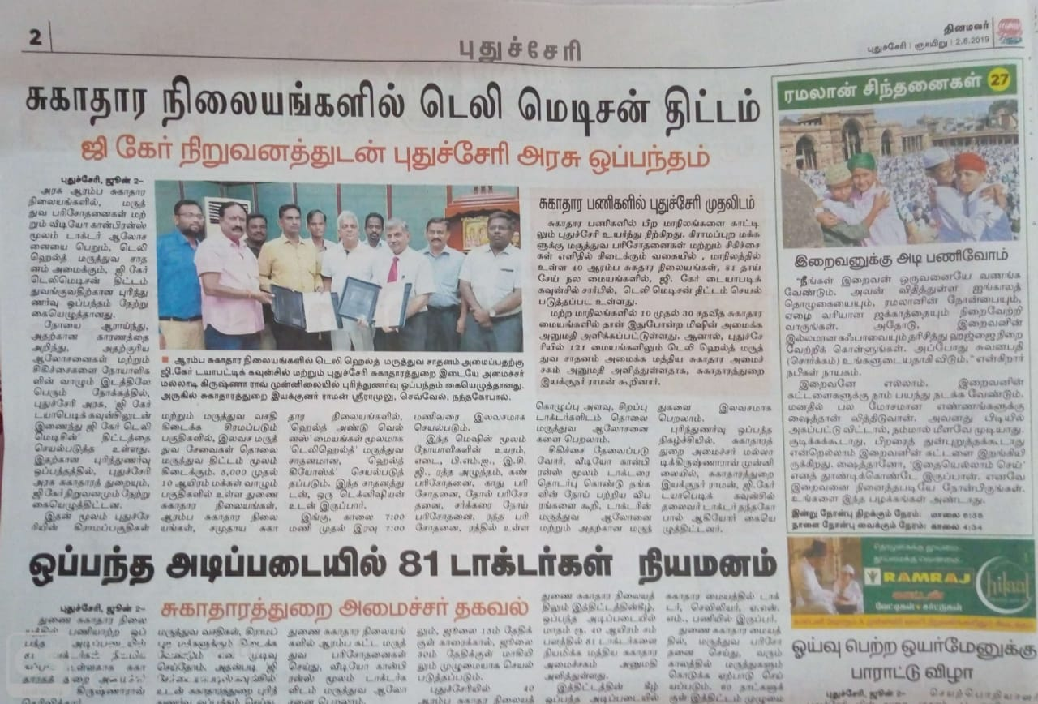
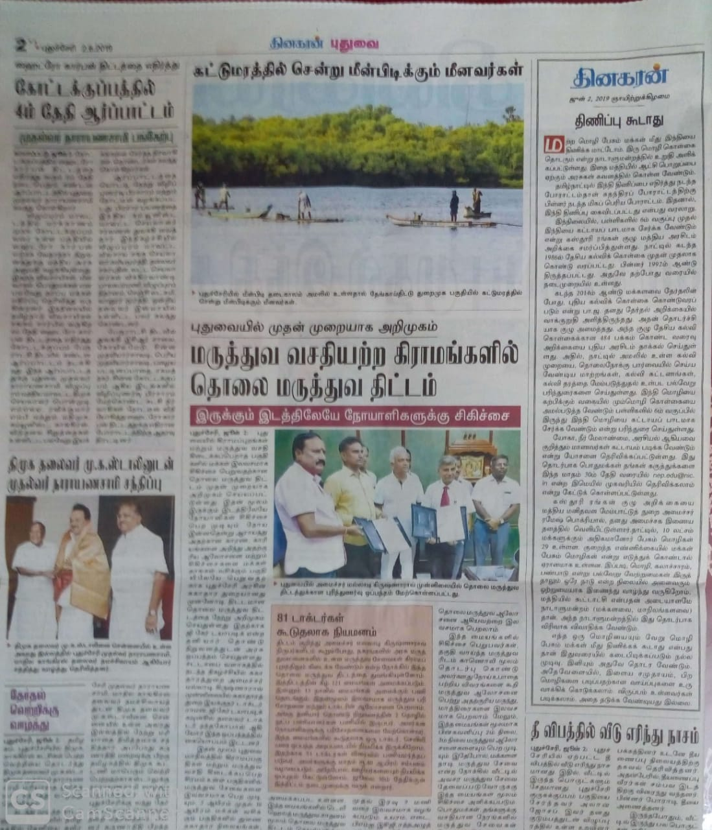
NEWSPAPER CLIPPINGS OF MOU SIGNED WITH GOVERNMENT OF PONDICHERRY DATED 2.06.2019 ABOUT OUR GCARE DIABETIC COUNCIL TELEMEDICINE PROJECT.
G- CARE DIABETIC COUNCIL

Slide 3
A Sensitization Programme was jointly organised by Health Department, Puducherry, and G Care Diabetic Council Puducherry, on 05.07.2019 at NHM Hall, Directorate of Health and Family Welfare, Puducherry. Dr. P.R.Nagendran, Director, GCDC, welcomed the gathering and introduced the members on the dais. The Keynote address was delivered by the Chairman, Dr. T.L. Nandagopal of G Care Diabetic Council Puducherry. Dr. K.V. Raman, Directorate of Health & Family Welfare, Puducherry, delivered his presidential speech and Special address was given by Dr. S. Mohan Kumar, The Mission Director (NRHM) Puducherry. Then the presentation about G Care Project was given by Dr. Kalimulla Sharif, CTO, Reach4cause Technologies, Bangalore. The Topics covered in the presentation were G Care Project, Concept Note, Our mission, Our vision G Care Health Hub service, Project implementation protocol etc.. Various doctors & officials from the Health Department, other government departments officials and bank staff have attended this programme. The Programme was ended with Vote of Thanks by Shri P.R. Rajagopal, Administrative Officer.
G- CARE DIABETIC COUNCIL

Slide 4
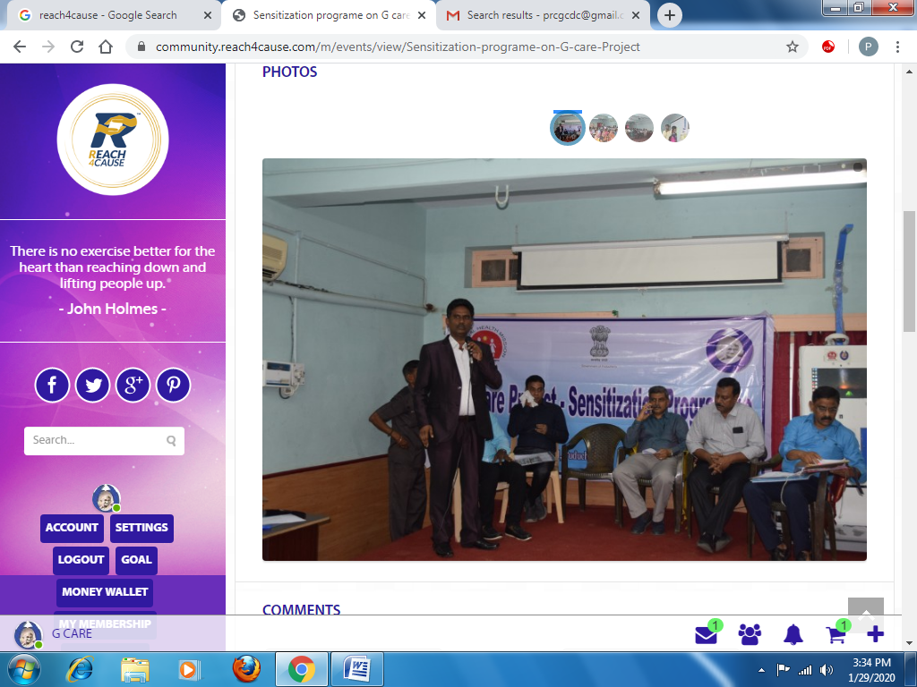
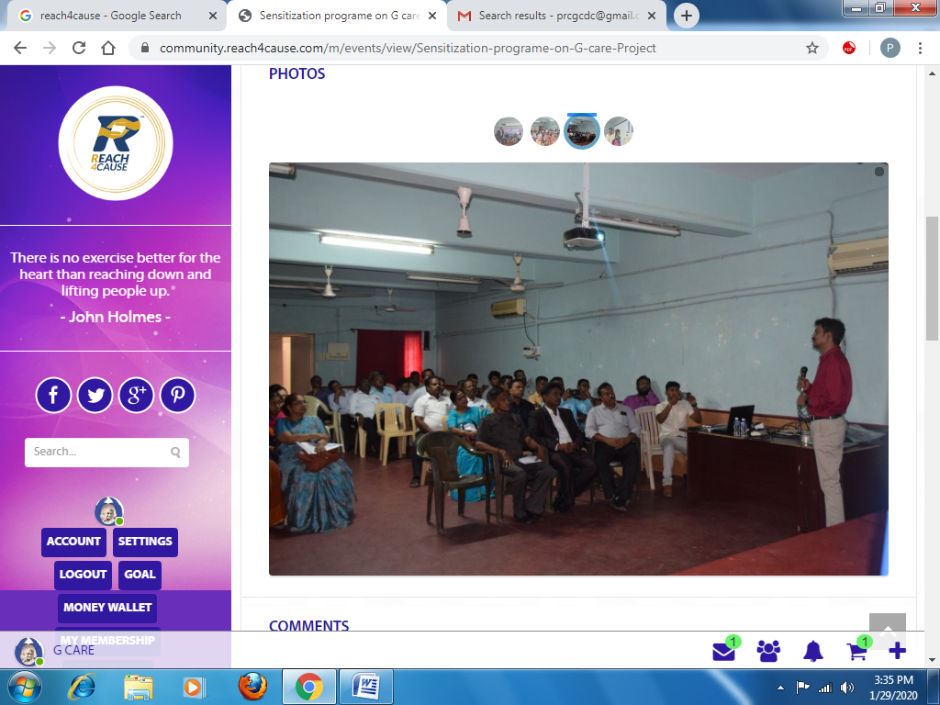
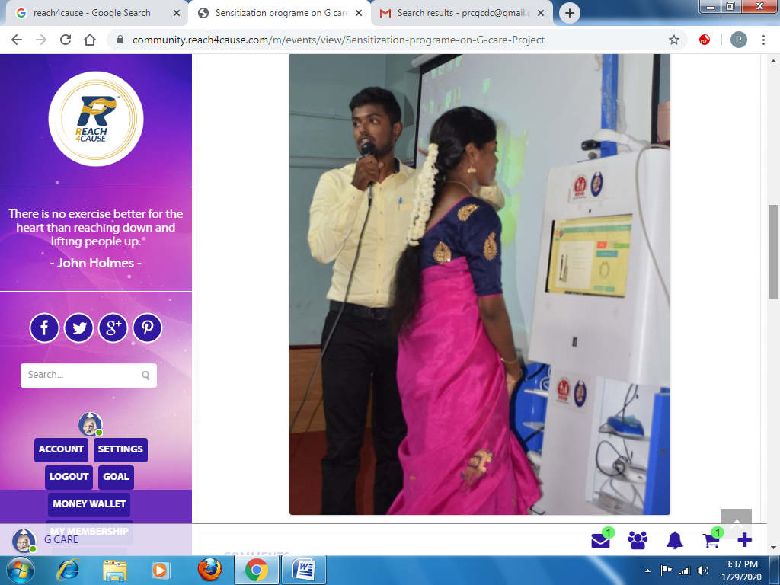
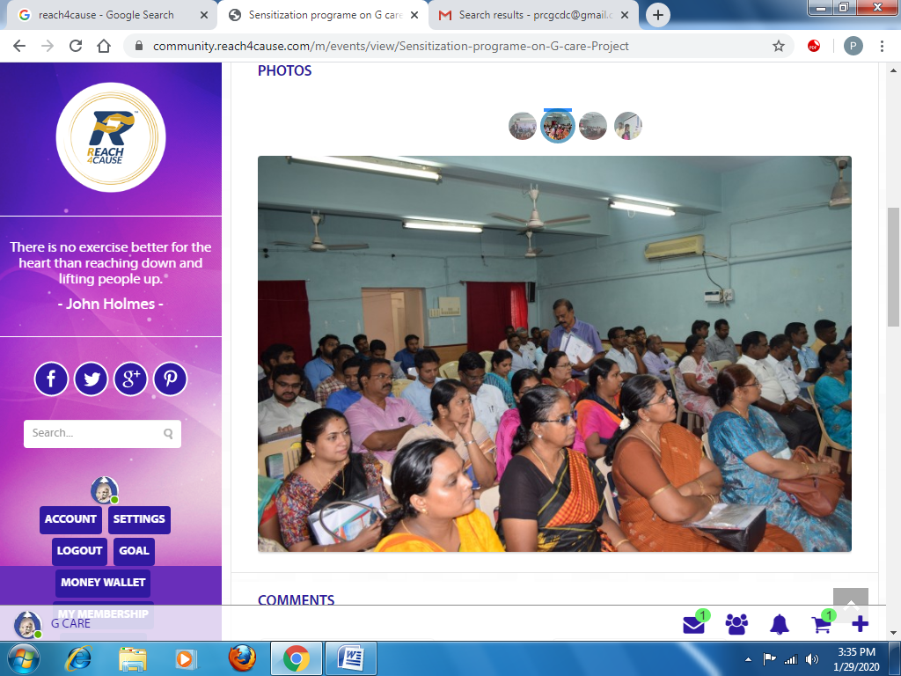
G- CARE DIABETIC COUNCIL

Slide 5
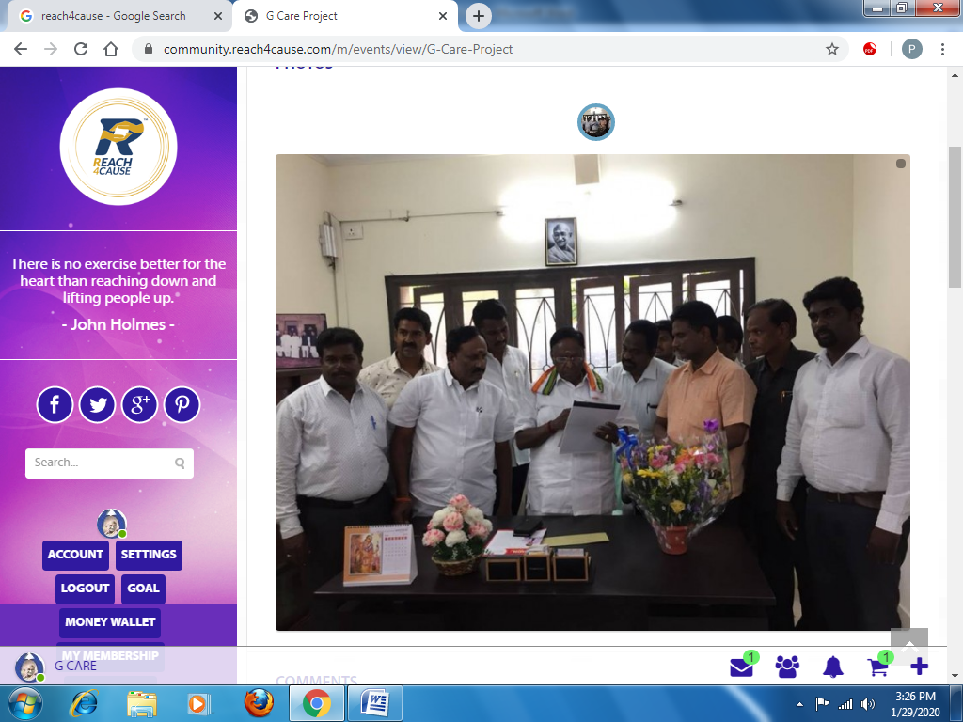
G- CARE DIABETIC COUNCIL
On 03.07.2022 GCDC Chairman DR.T.L.Nandagopal explaining about the G-Care Project to Hon’ble Puducherry CM Mr.Narayanaswamy

Slide 6
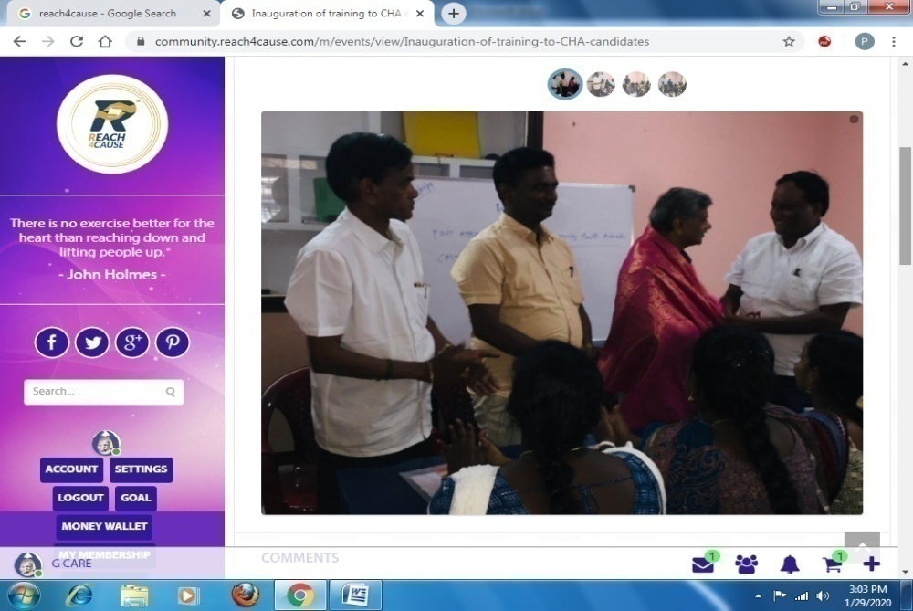
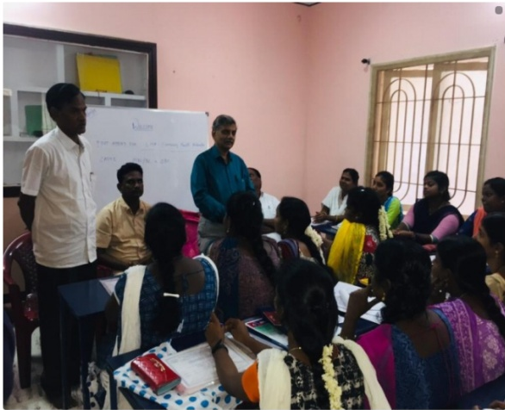
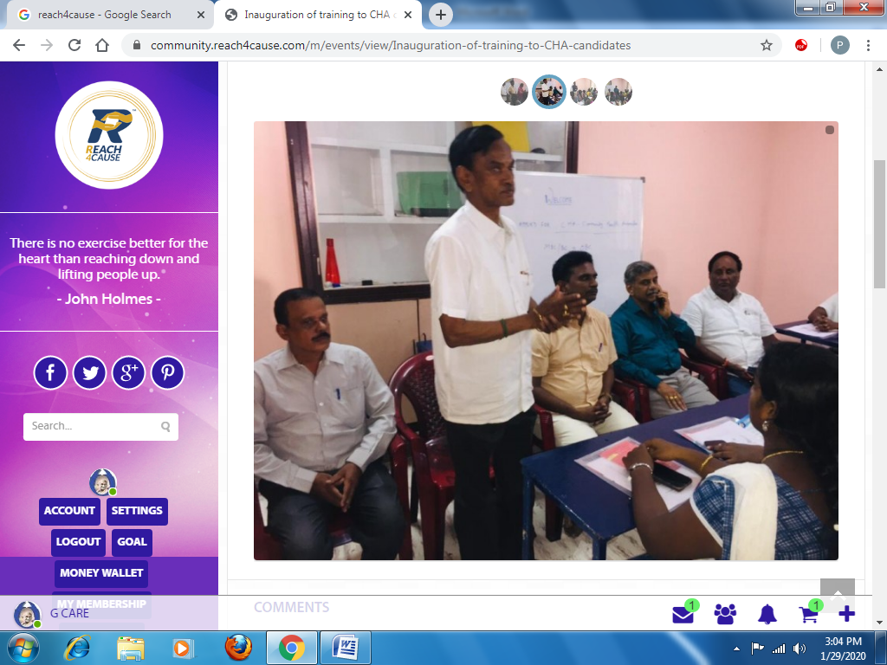
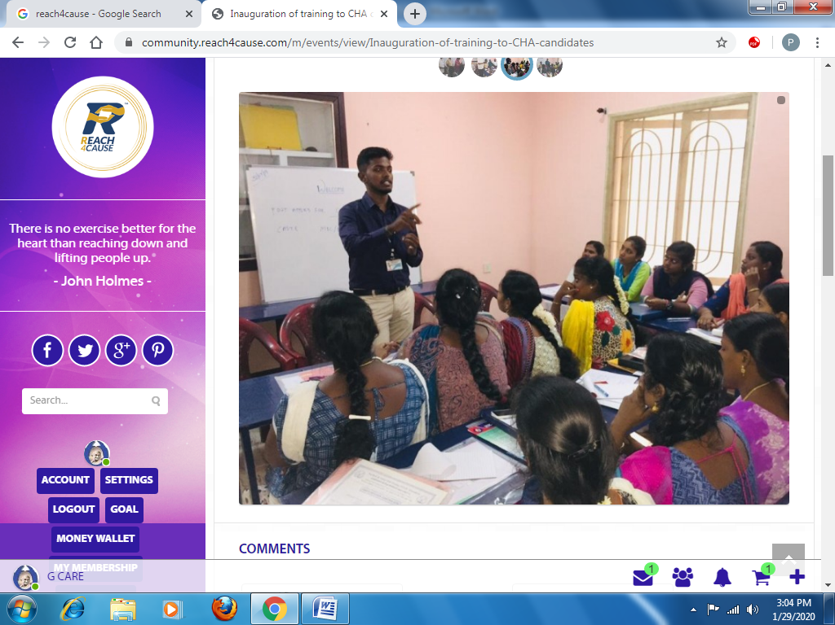
G- CARE DIABETIC COUNCIL
Inauguration of training to CHA candidates was held on 31st July 2019 at G Care Diabetic Council, Pondicherry. Our Director Mr. Nagendiran welcomed the gathering chief Guest, Dr. K.V. Raman, Director(Health) inaugurated the function and informed the candidates about their growth opportunities in this company. Our chairman, Mr. T.L. Nandagopal delivered his speech about the duties and responsibilities of the CHAs at the centre. Vote of thanks was given by the Administrative Officer Mr. P.R. Rajagopal.

Slide 7
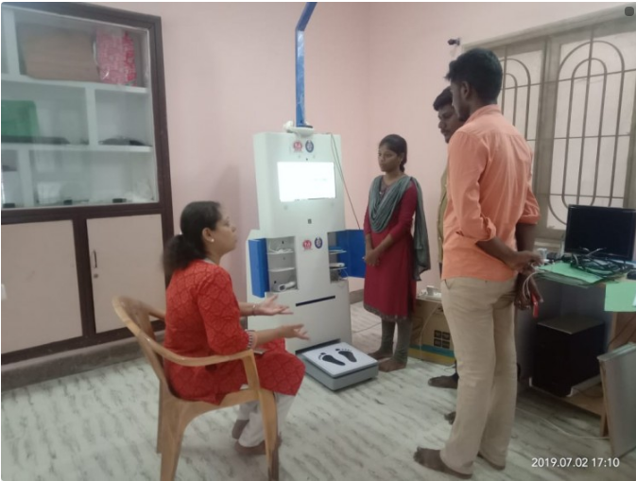
G- CARE DIABETIC COUNCIL
On July 2nd 2019 at 5.42 Pm. Ms. Vidya Ramkumar visited our Office. Kiosk machine demo was given to her by Selvi. Thangam & Mr. Shanmugavel.

Slide 8
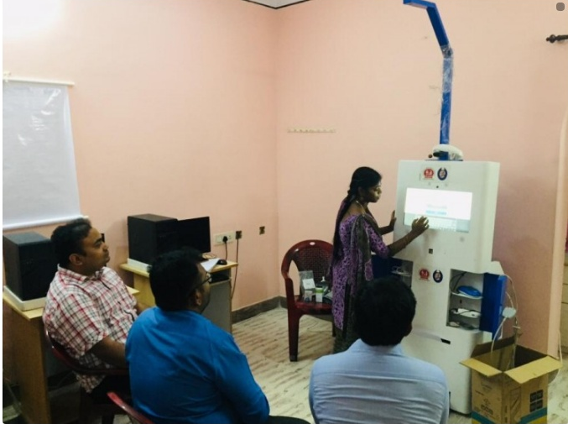
G- CARE DIABETIC COUNCIL
On July 24th 2019 as a 4.18 pm Dr. Duraisamy along with 4 officials from ICMR, Delhi visited our office, Kiosk Machine Demo was given them by Selvi. Thangam.

Slide 9
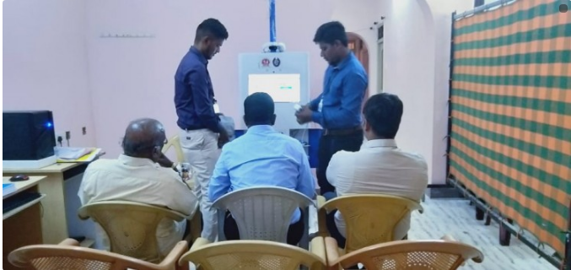
G- CARE DIABETIC COUNCIL
On July 31st 2018 at 19.24 am. Mr. Saravanan & Mr.Ravichandiran of Kotak Insurance, Chennai visited our office. Kiosk machine demo was given to them by Mr. Lakshmanan.

Slide 10
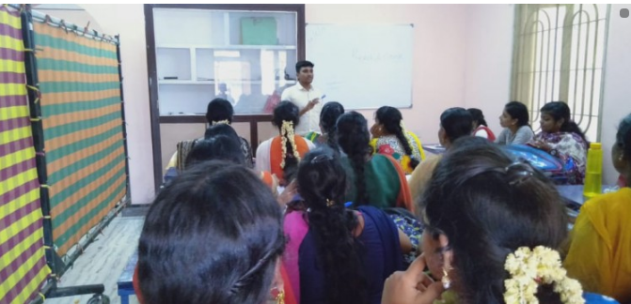
G- CARE DIABETIC COUNCIL
Explaining Reach4cause to training candidate in G-Care office in Puducherry on 20.08.2019 by Mr.Prem from Reach4Cause Team, Bangalore.

Slide 11
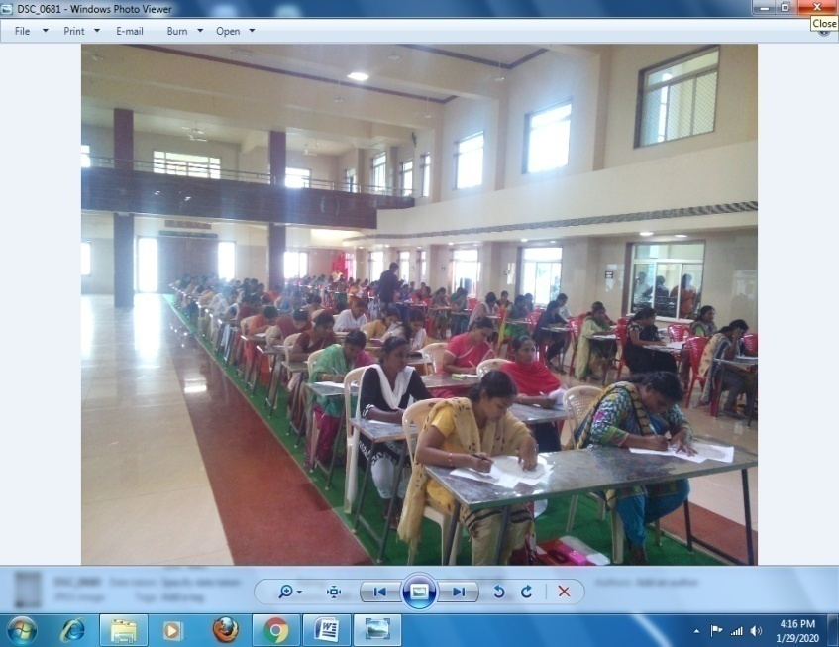
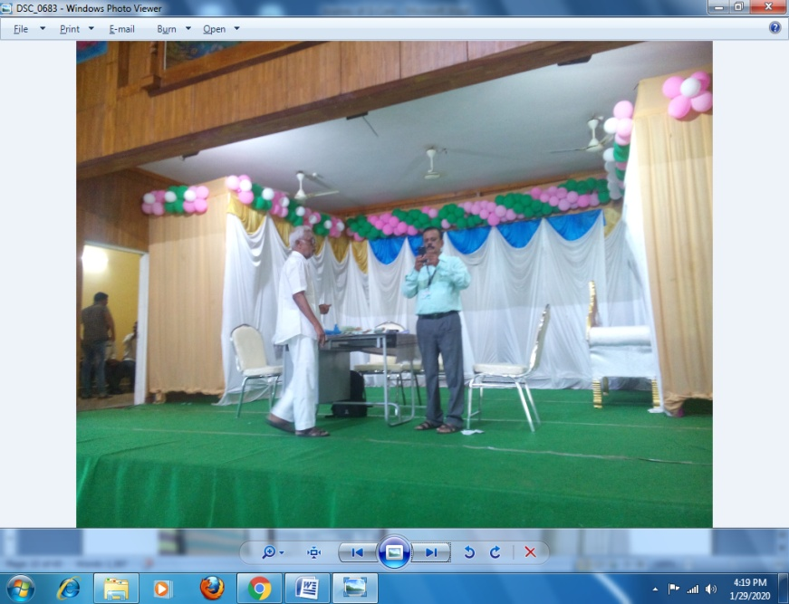
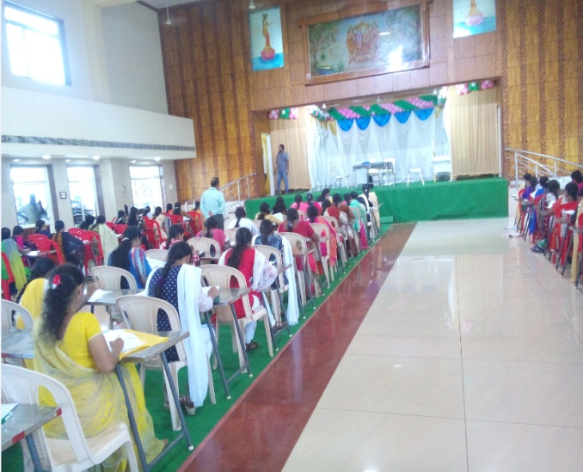
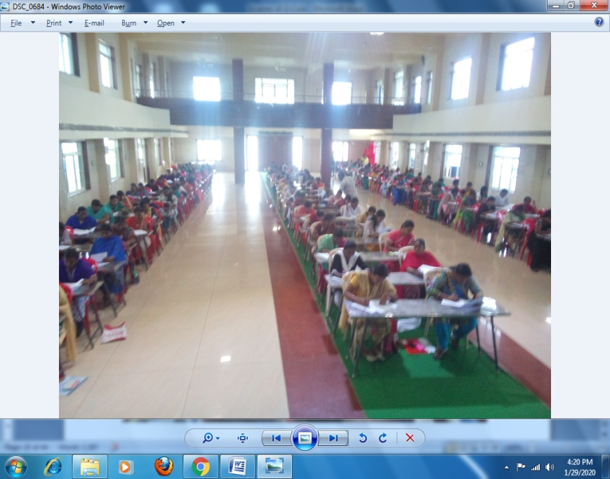
G- CARE DIABETIC COUNCIL
Exam conduted to ccandidates for Cummunity health ambossader post in Yanam with support of NGO-Yanam Old Age Home team in Thirumana mandapam on 9th Aug 2019.

Slide 12
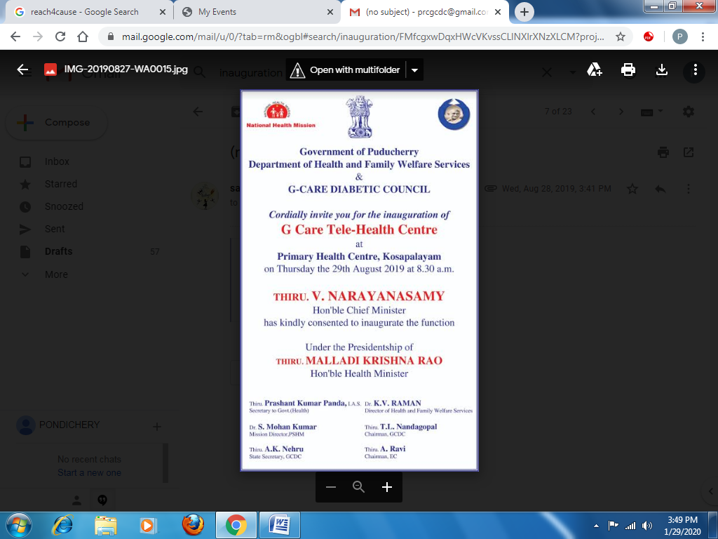
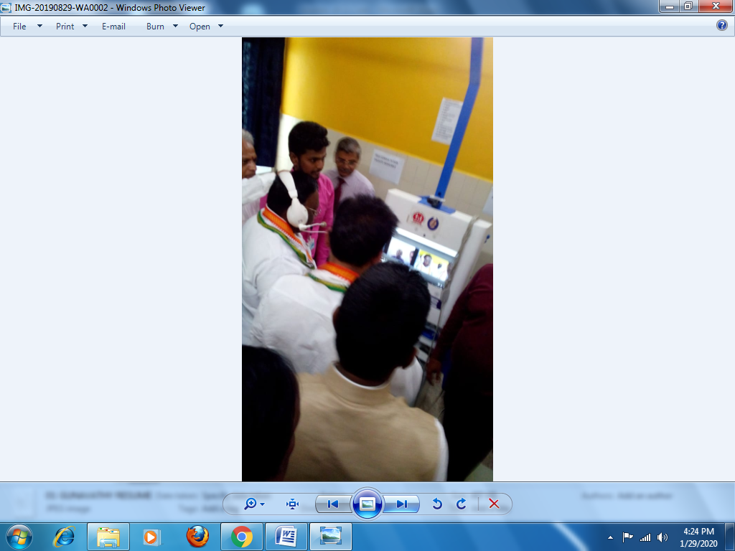
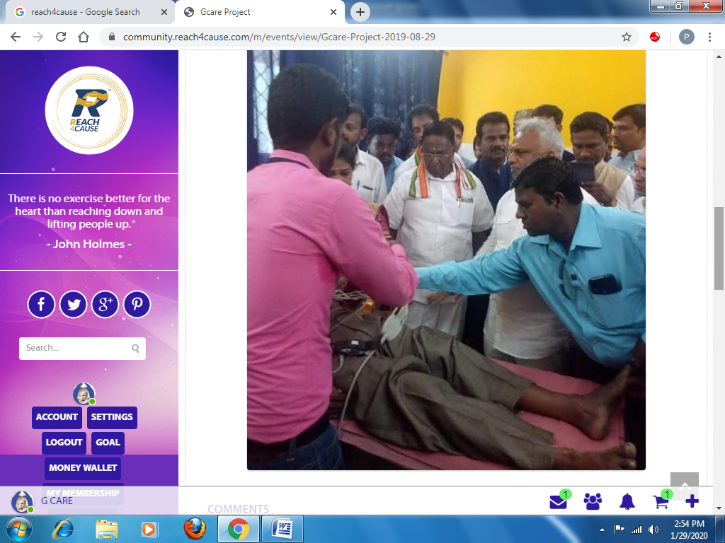
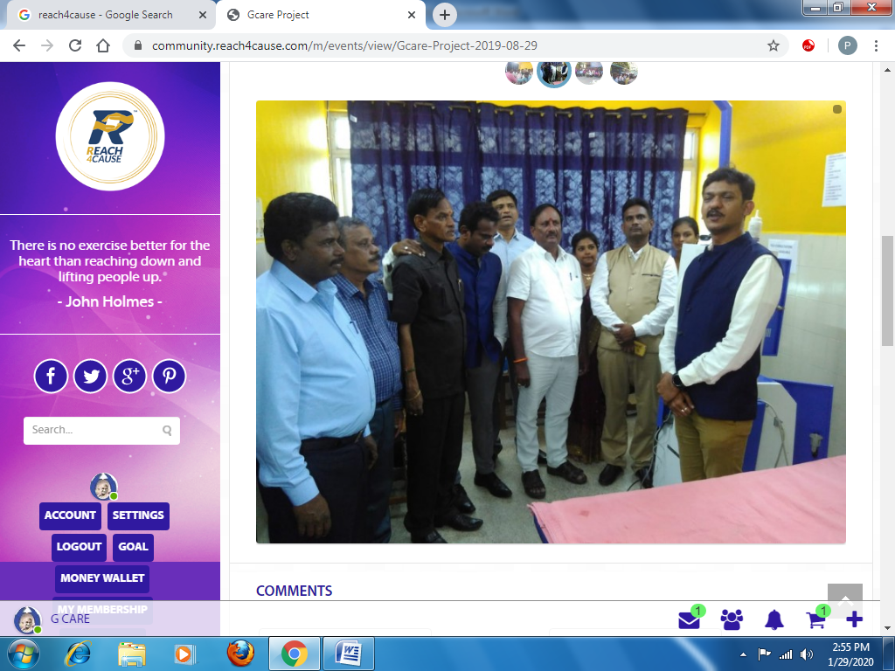
G- CARE DIABETIC COUNCIL
Puducherry Chief Minister Inaugurated G care Tele- Health centre at Kosapalayam PHC, Puducherry today 29.08.2019. the other Govt. official members participated in the function were Health Minister, Special representative of the Puducherry and ministration in New Delhi, Secretary to Govt. (Health), Director of Health, Mission Director, Executives from Reach4cause and NUHM were also present the Chief Minister Spoke to the press above the various benefits to poor people through this Tele- Health Centre. The function was a grand success and all were happy about this initiative.

Slide 13
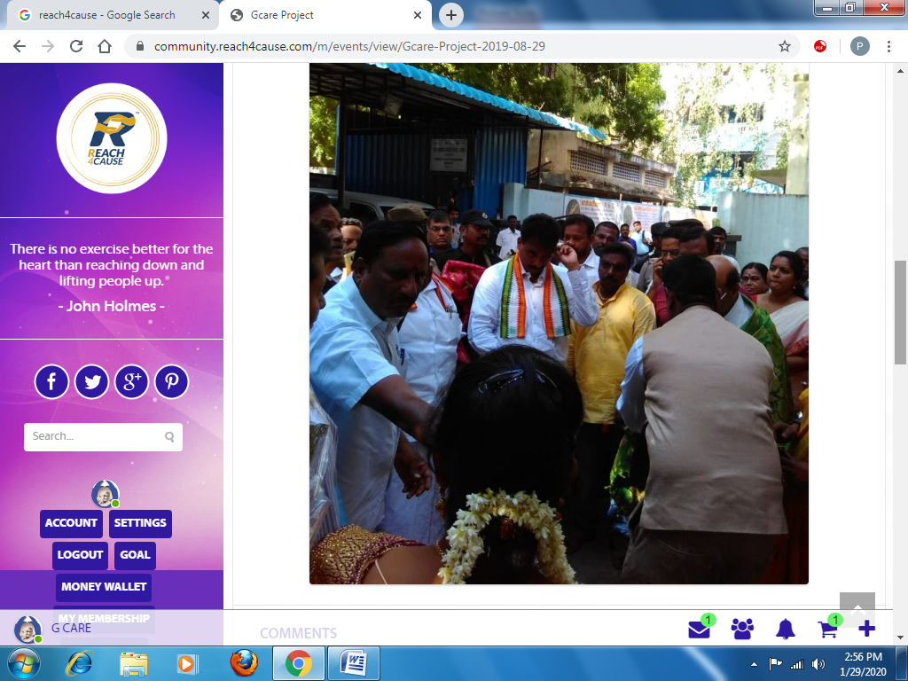
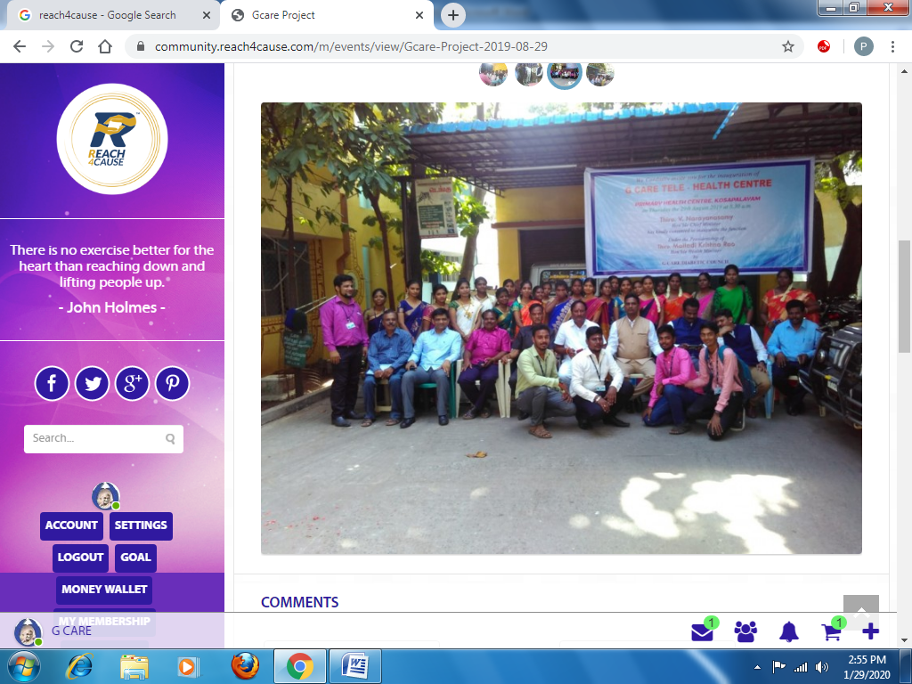
G- CARE DIABETIC COUNCIL

Slide 14
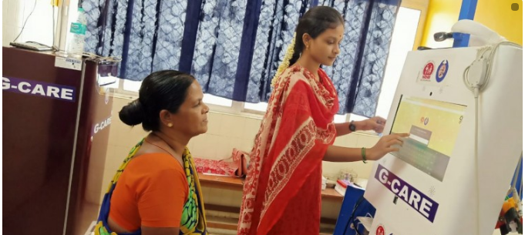
G- CARE DIABETIC COUNCIL
A Patient is being given Health Check up at G Care Kosapalayam Centre Pondicherry by our Community Health Ambassador on 05/09/2019.

Slide 15
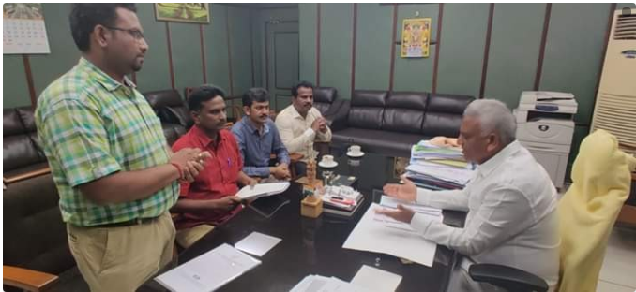
G- CARE DIABETIC COUNCIL
G-care and Govt. Of Puducherry implementing Telemedicine for 121 integrated Primary Health Centre’s Over all Puducherry State discuss with Honorable Health Minister Mr. Malladi Krishna Rao, Puducherry, G-care Chairman Mr. Nanthagopal Inviting interested social entrepreneurs and NGO’s for Project on 06.09.2019

Slide 16
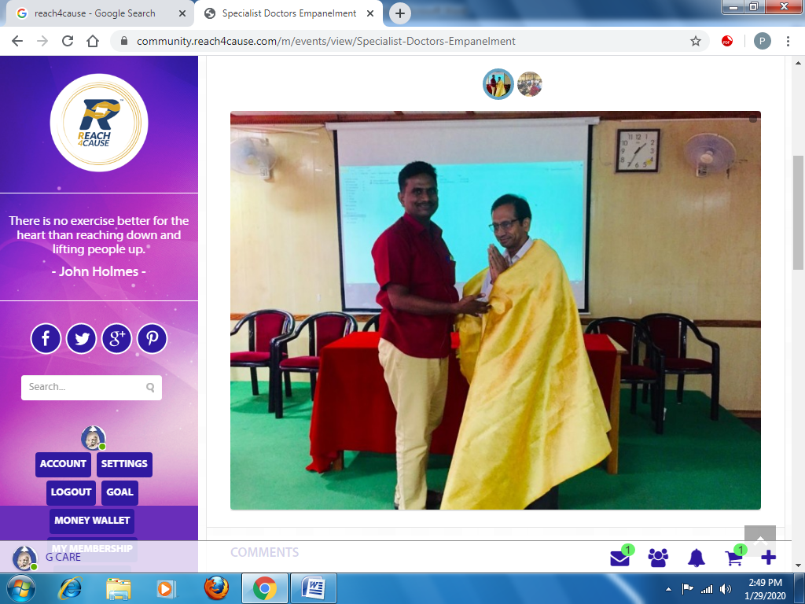
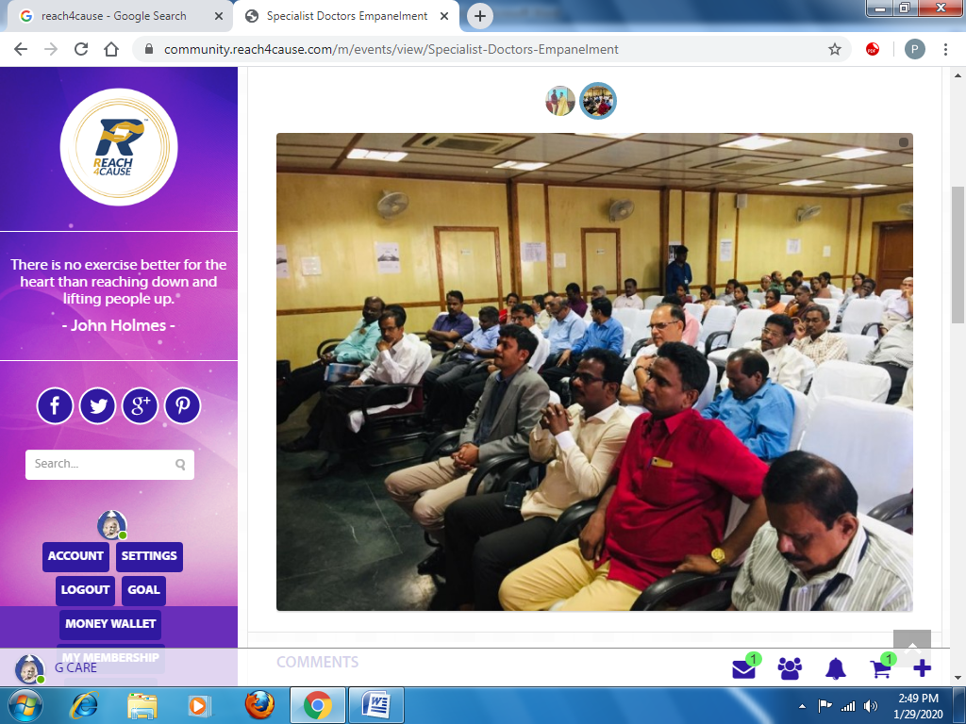
G- CARE DIABETIC COUNCIL
Empanelment Meeting was held at IGGGH Conference Hall Puducherry on 06.09.2019 Health Department official, Medical Superintendent, RMO, Public Relation Specialist Doctors have attended this meeting Shri. Manjunath and Shri. Kalim from Reach4cause took part in this meeting, shri kalim gave a presentation of the Tele Medicine Project and its benefits to the doctors in this project on 06.09.2019

Slide 17
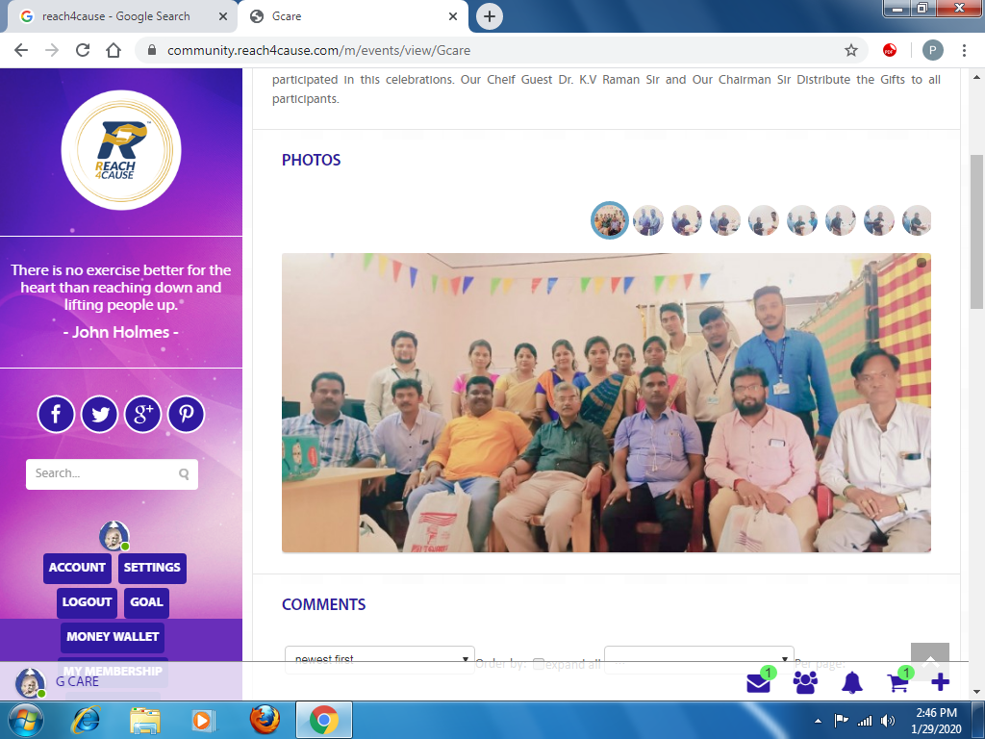
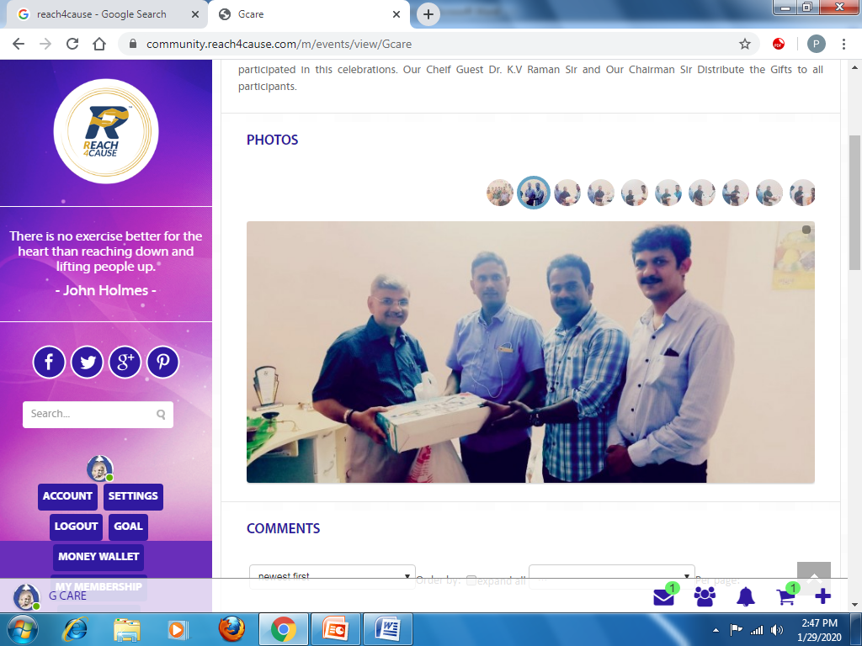
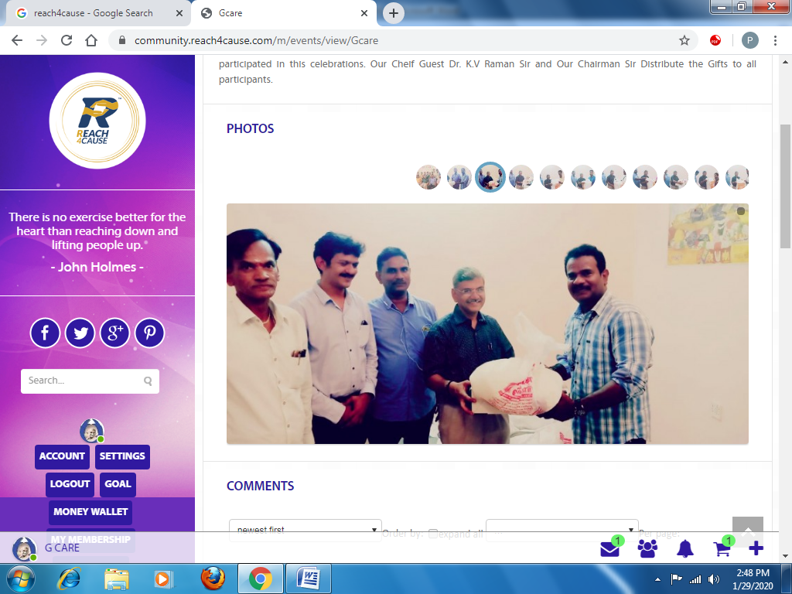
G- CARE DIABETIC COUNCIL
We celebrate the Aayuda Pooja Celebration on Monday 7th October 2019 at our office G-Care Diabetic Council, 99, Ellaiamman Koil Street, Pondicherry - 605004. Dr. K.V Raman Sir, NRHM Team Dr. Duraisamy Sir, Reach4Cause Team Dr. Kalimullah Sherif Sir and Mr. Manjunathan Sir, Medango Team Managing Director Mr. Balaji Sir, Engineer Mr. Yadavaraj Sir and Our Hon'ble Chairman Dr. T.L. Nandagopal Sir and Our Director Mr. Nagendiran Sir, along with G-Care Staffs participated in this celebrations. Our Chief Guest Dr. K.V Raman Sir and Our Chairman Sir Distribute the Gifts to all participants.

Slide 18
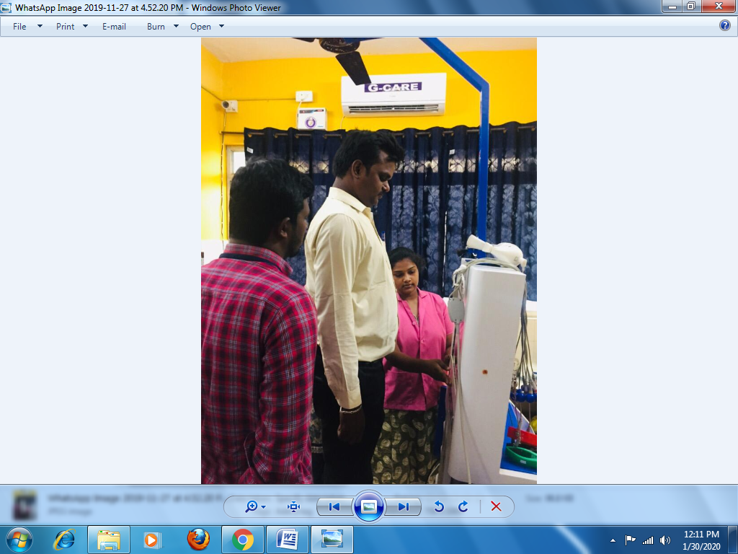
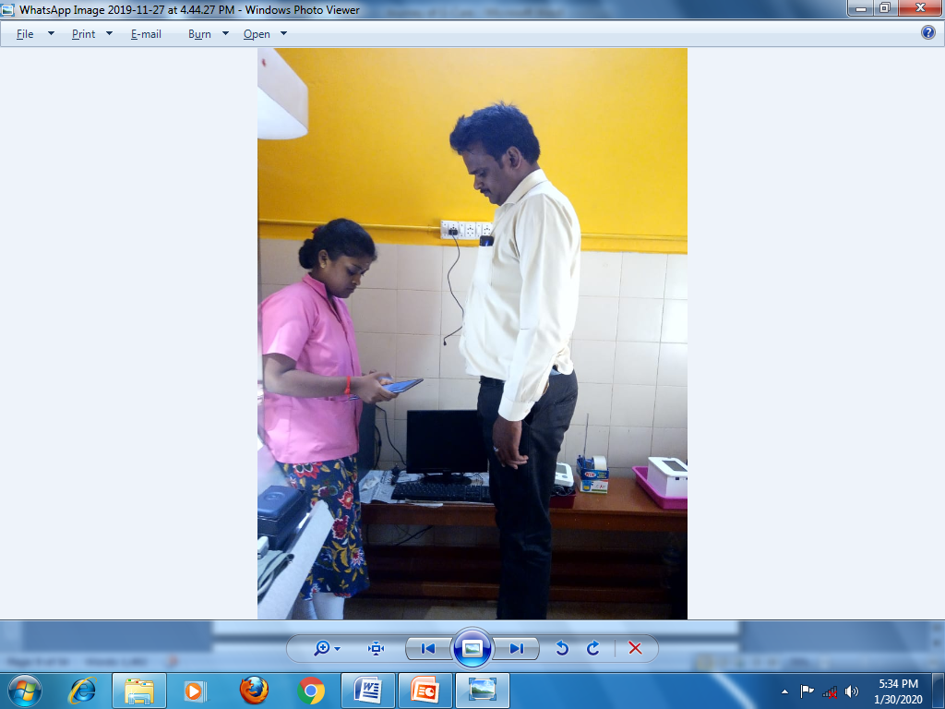
G- CARE DIABETIC COUNCIL
CSC e-Government staff visited to G-CARE telemedicine centre at Kosapalayam PHC and Lawspet PHC on 4th November 2019

Slide 19
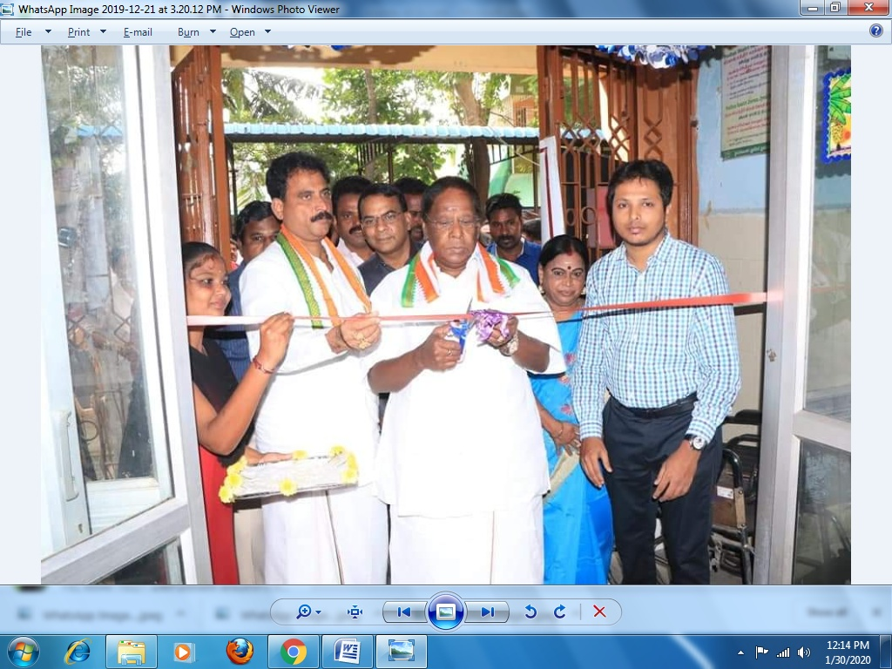
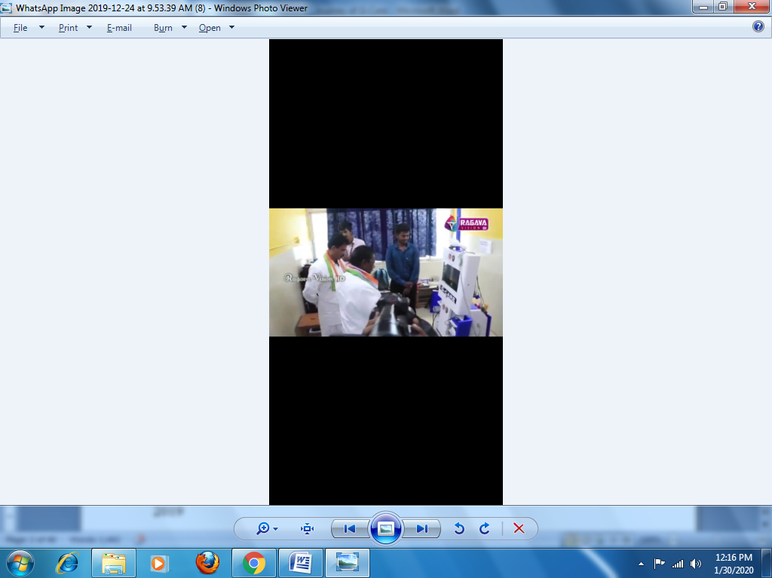
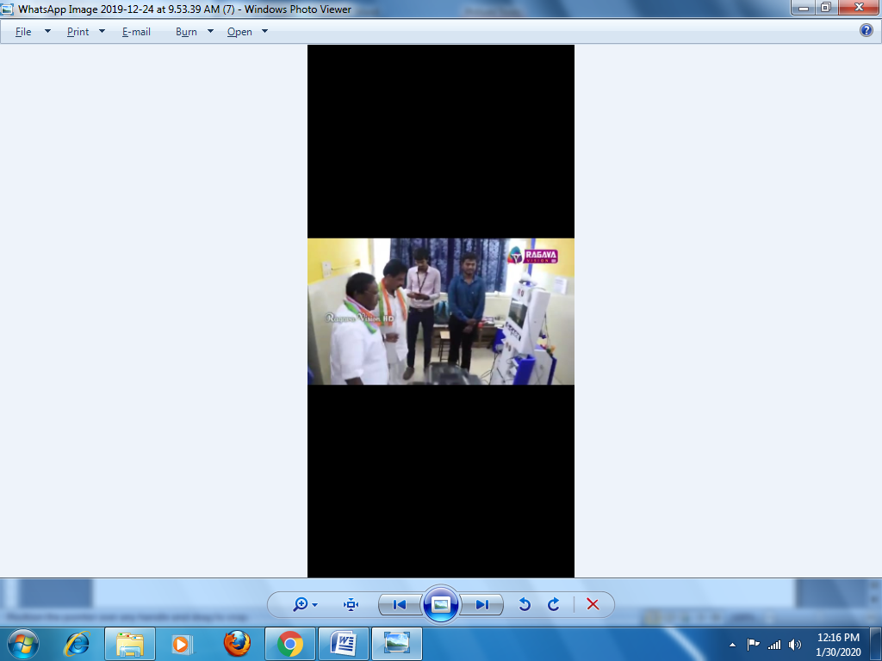
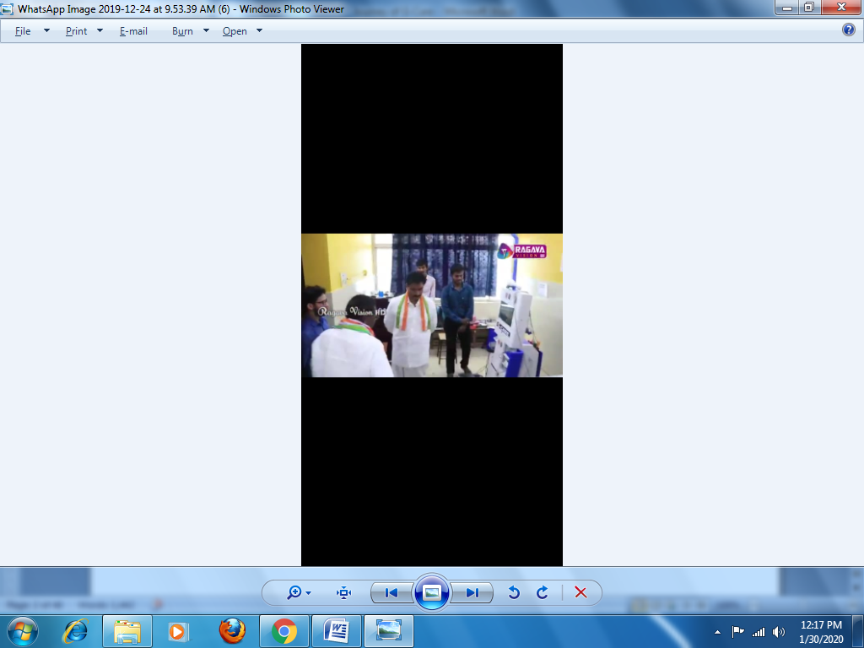
G- CARE DIABETIC COUNCIL
Health & Wellness centre inauguration at Kosapalayam on 21st December 2019 by Mr. Narayanaswamy, Hon’ble CM Puducherry

Slide 20
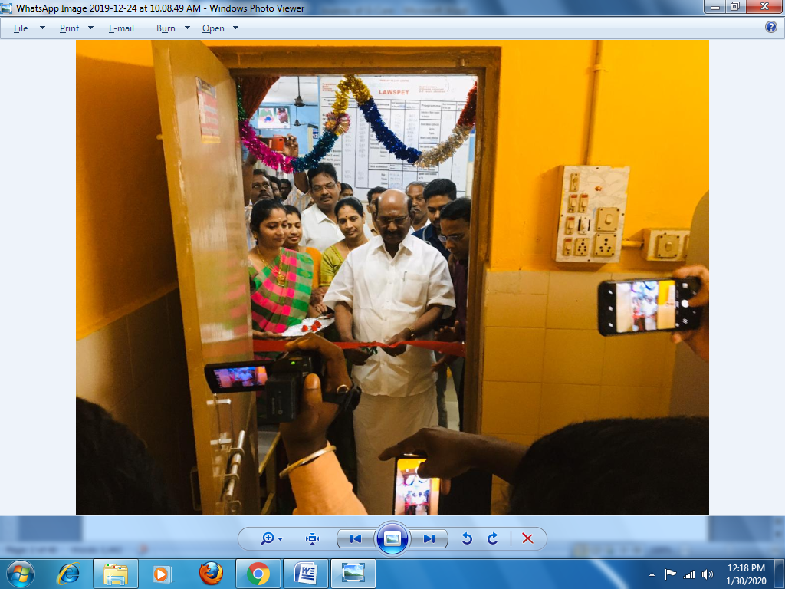
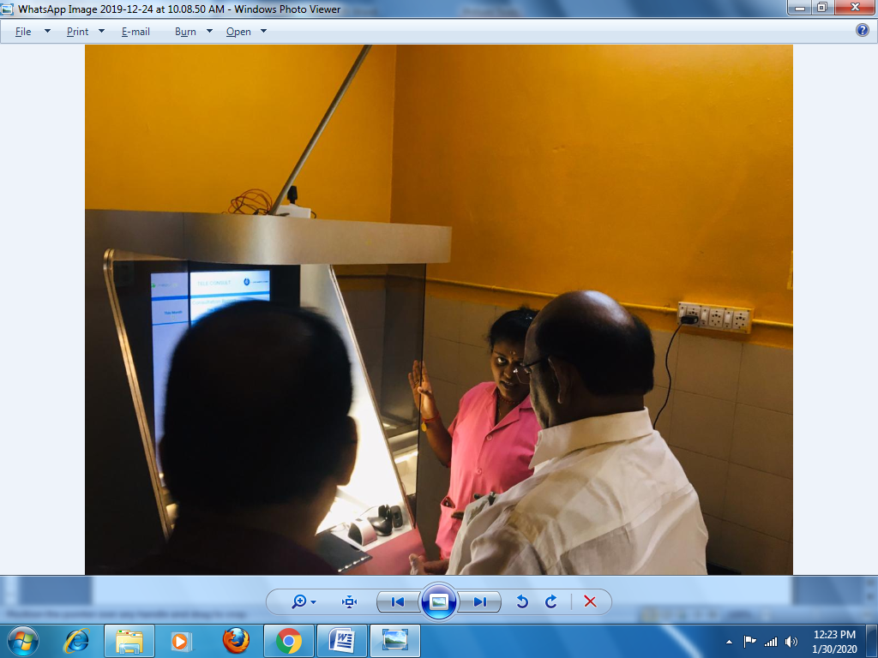
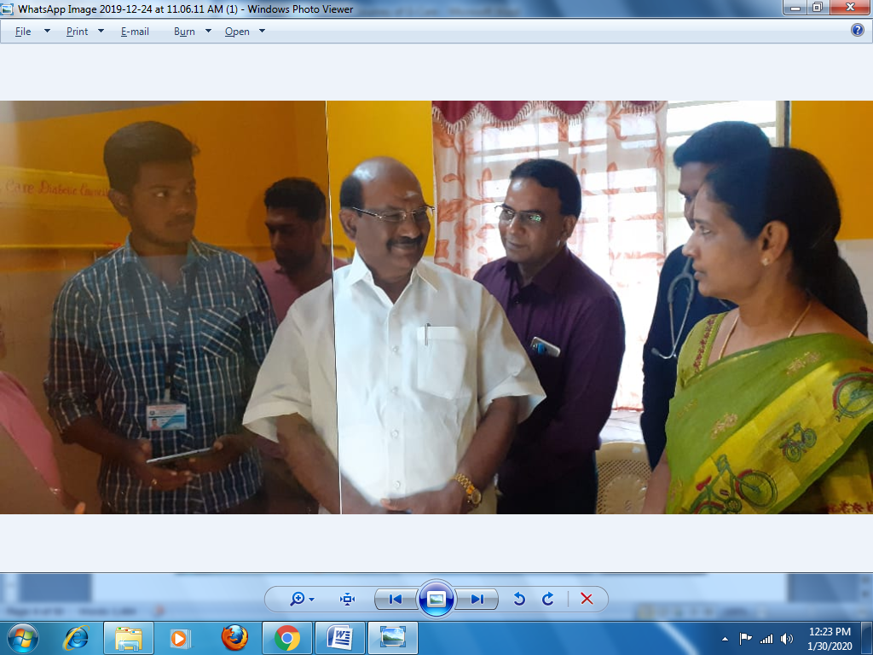
G- CARE DIABETIC COUNCIL
Health & Wellness centre inauguration at Lawspet on 24th December 2019 by Mr.Sivakozhundu MLA, Hon’ble Legislative assembly speaker Puducherry.

Slide 21
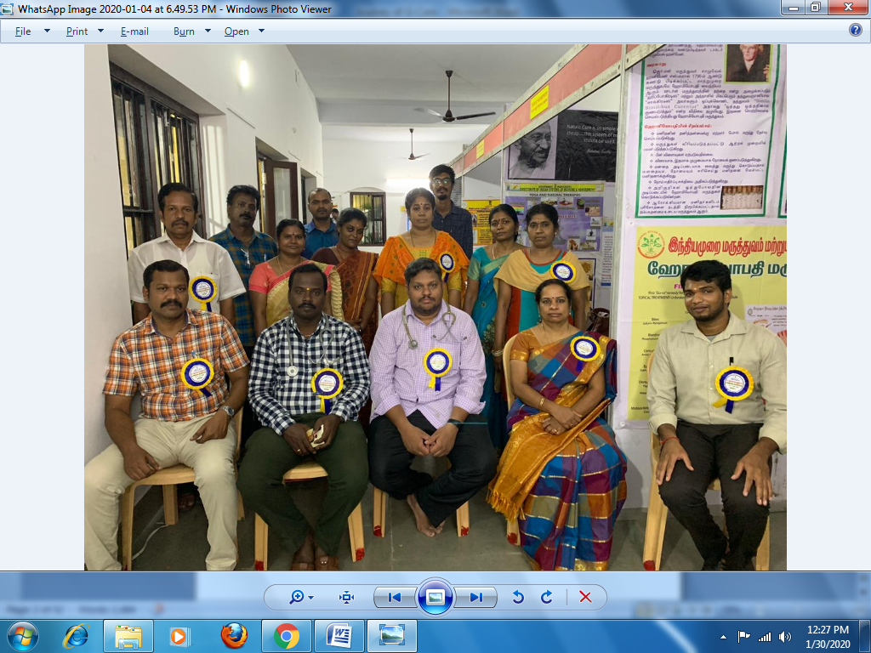
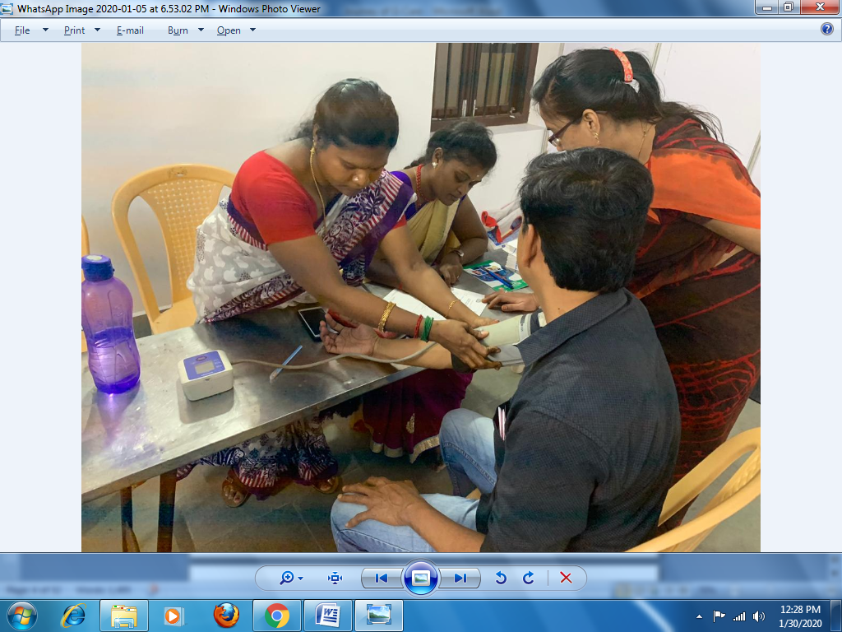
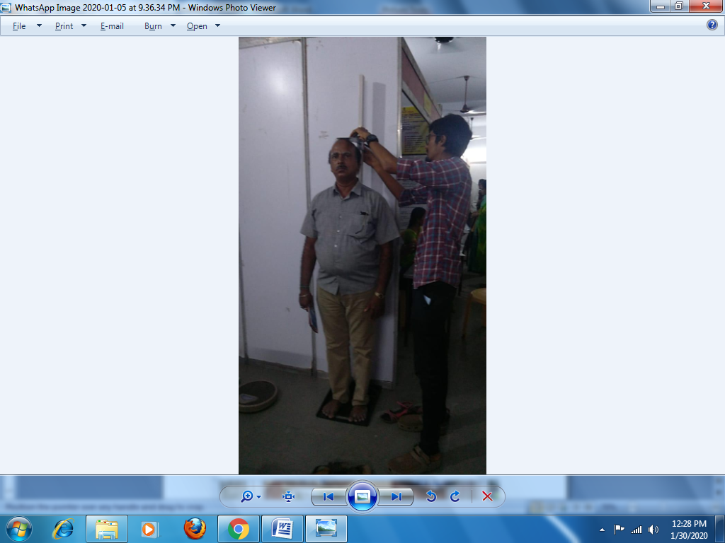
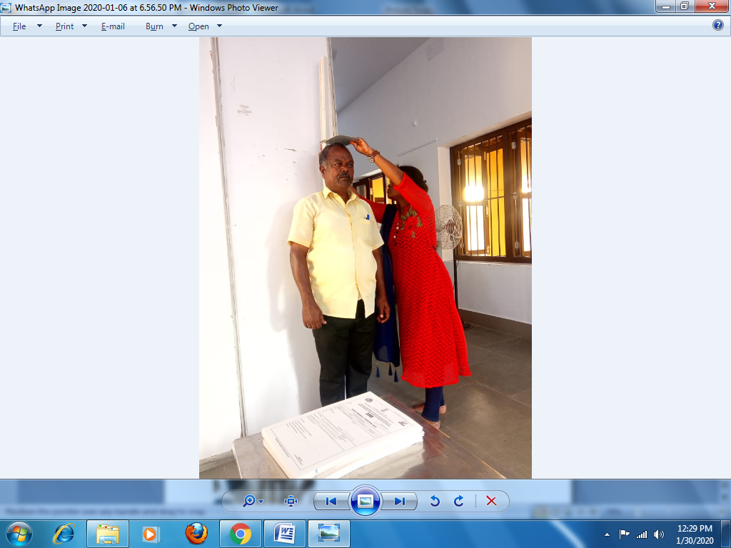
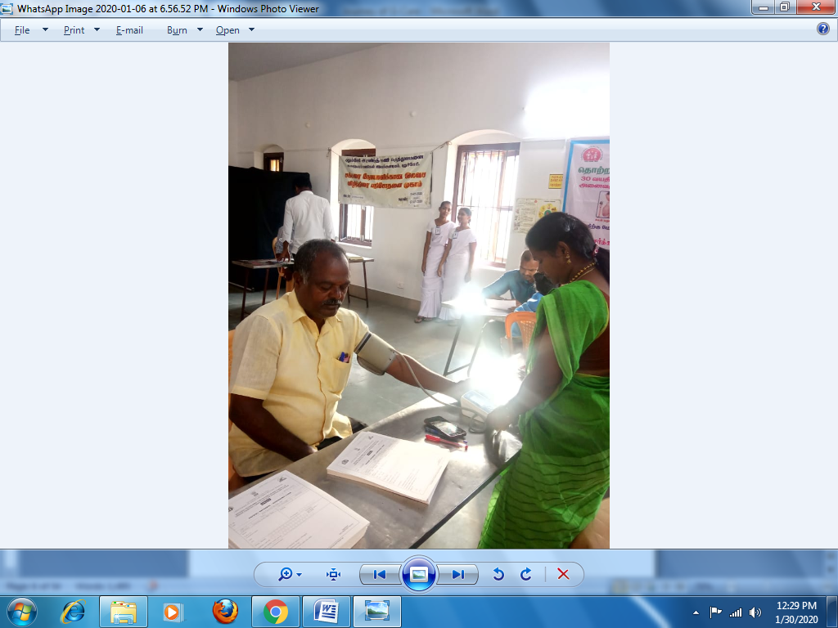
G- CARE DIABETIC COUNCIL
Murugampakkam Medical CAMP on 4th ,5th ,6th and 7th January 2020

Slide 22
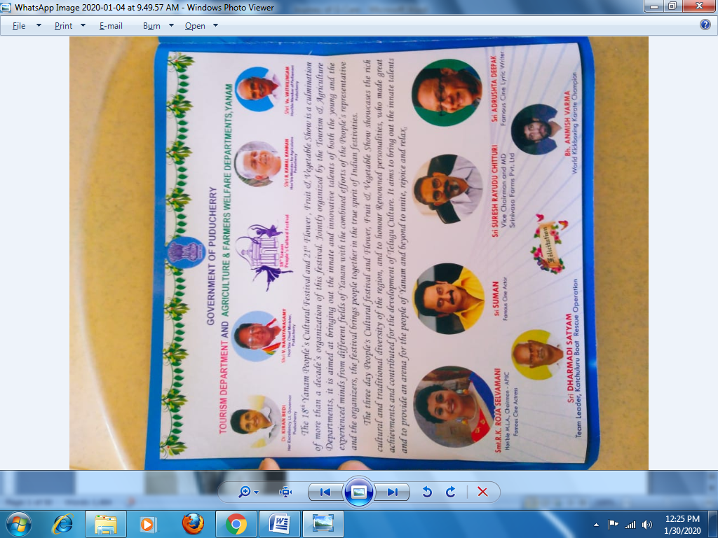
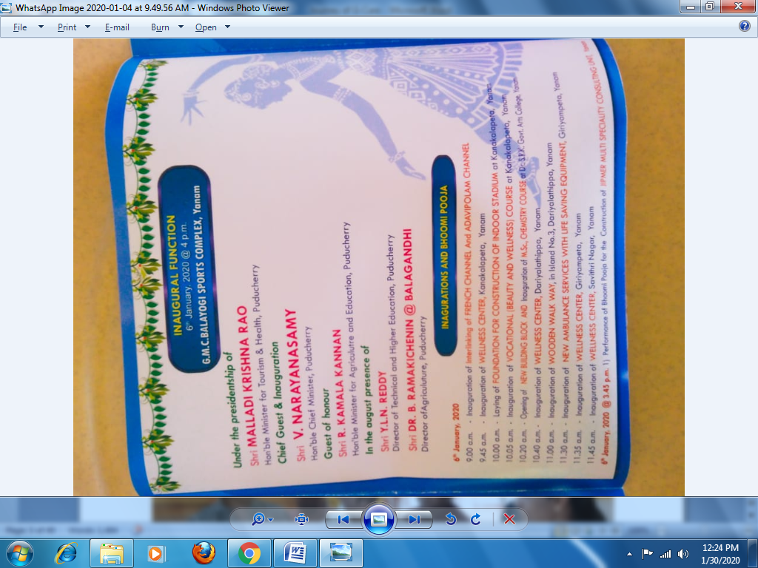
G- CARE DIABETIC COUNCIL
Yanam Inauguration on 6th Jan 2020 (5sub centre inuagrated) by Mr.Narayanaswamy, Hon’ble CM Puducherry and Mr.Malladi Krishna Rao MLA, Hon’ble Health Minister, Puducherry.

Slide 23
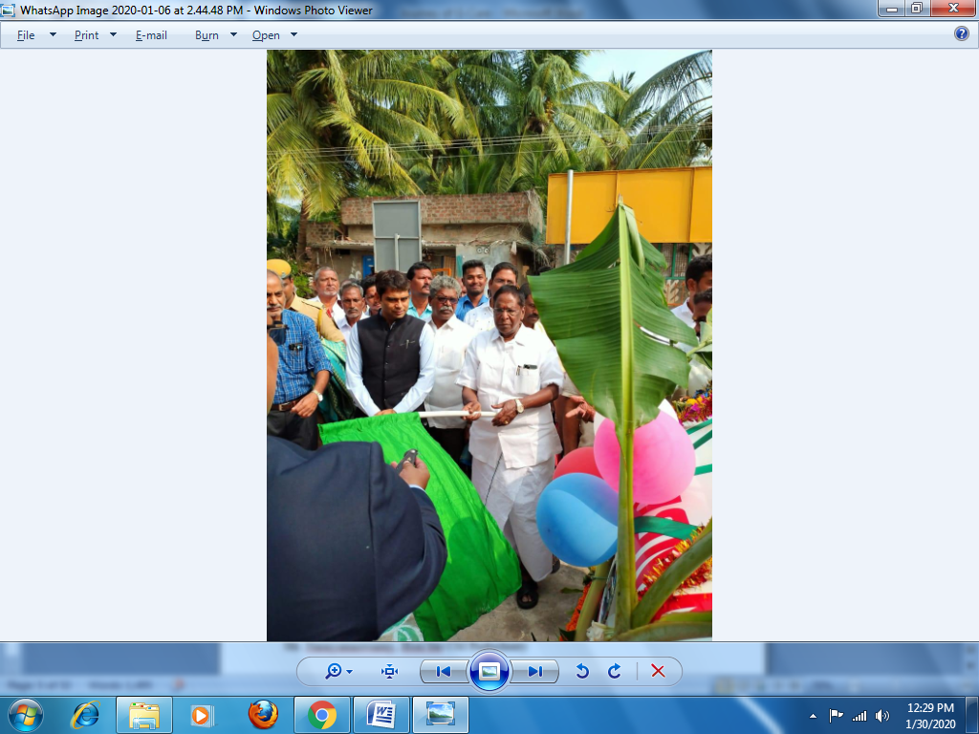
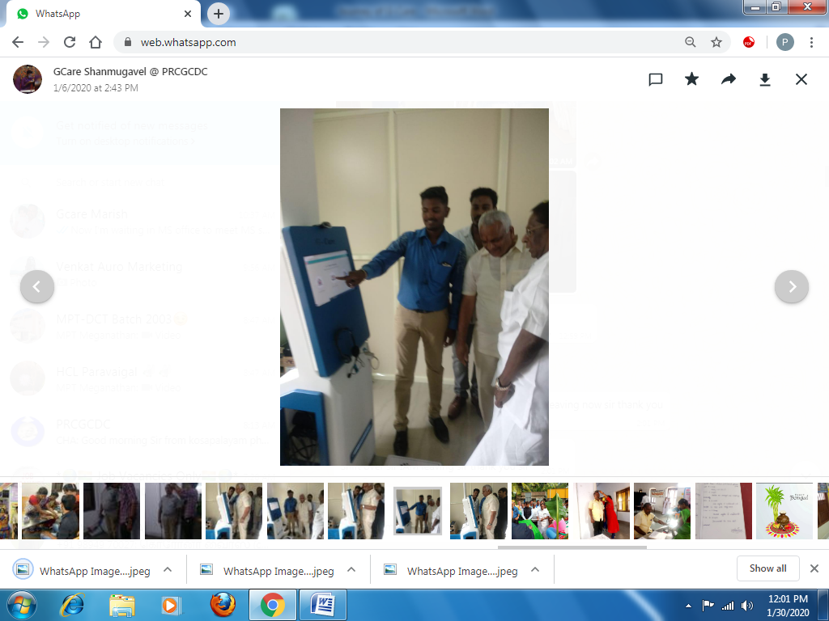

G- CARE DIABETIC COUNCIL

Slide 24


Covid-19 vaccination Camp
Our hon’ble Lieutenant governor of Puducherry inaugurated covid vaccination camp. Our G-Care staff Mrs Arunika.S participated in camp. On 14.04.2021

Slide 25


G- CARE DIABETIC COUNCIL
On June 18th 2021 Our chairman Dr.T.L. Nandhagopal and Former Director of Health and Family Welfare Dr.K.V. Raman met Hon’ble Chief Minister of Puducherry Thiru.N. Rangasamy and explained him about our journey of Gcare & our participation in combating covid-19.

Slide 26


G- CARE DIABETIC COUNCIL
13.05.2022 MET CM OF PUDUCHERRY REGARDING FURTHER FUNCTION

Slide 27

G- CARE DIABETIC COUNCIL
08.03.2022 NCD CAMP AT THAVALAKUPPAM , THIRU EMBALAM R SELVAM, SPEAKER-PUDUCHERRY LEGISLATIVE ASSEMBLY , DMS DR SRIRAMALU, INAUGRATED THE CAMP

